Slide 2
Acts 17:17 (in Athens)
So he [Paul] reasoned in the synagogue with both Jews and God-fearing Greeks, as well as in the marketplace day by day with those who happened to be there.
See also:
Acts 17:2 (in Thessalonica)
18:4 (in Corinth)
18:19 (in Ephesus)

Slide 3
Today’s “Tough” Question
How Was God Always Alive?
(How Does God Exist?)

Slide 4
The Questions
How was God always alive?
Was God always alive?

Slide 5
The Questions
How was God always alive?
Was God always alive?
Did God have a beginning?

Slide 6
The Questions
How was God always alive?
Was God always alive?
Did God have a beginning?
Does everything have a beginning?

Slide 7
Does Everything Have a Beginning?
It is logically and scientifically impossible for everything to have had a beginning

Slide 8
Does Everything Have a Beginning?
Assume:
Everything that exists, or has existed, had a beginning

Slide 9
Does Everything Have a Beginning?
Steven Edward Coleman
Born: October 8, 1960
To: Michael Keith Coleman (19 Yrs)
Carolyn Marie Coleman (19 Yrs)
Hospital: A small Army Hospital
City, State: Staten Island, N.Y.
1700
1800
1900
1960
2000
Time (Years)

Slide 10
Does Everything Have a Beginning?
1700
1800
1900
1959
2000
Time (Years)

Slide 11
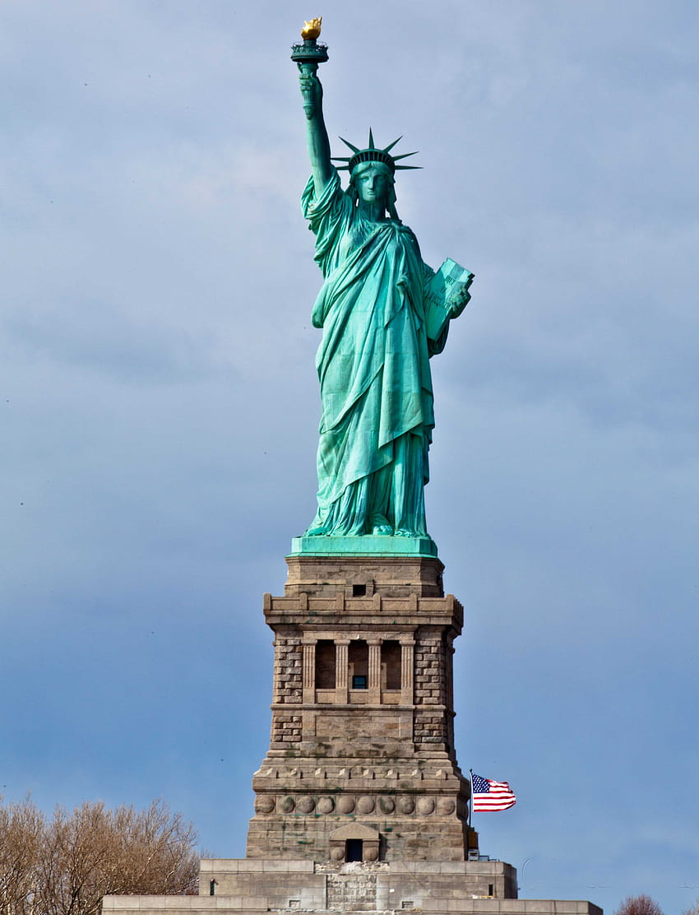
Does Everything Have a Beginning?
Statue of Liberty
Built: 1876
Location: Ellis Island
City, State: N.Y., N.Y.
1700
1800
1876
1900
2000
Time (Years)

Slide 12
Does Everything Have a Beginning?
1700
1800
1875
1900
2000
Time (Years)

Slide 13
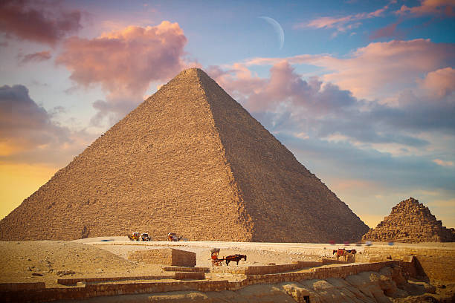
Does Everything Have a Beginning?
Great Pyramid of Giza
Built: ~2600 BC
Location: Giza, Egypt
3000 BC
2600 BC
2000 BC
1000 BC
1 AD
500 AD
Time (Years)

Slide 14
Does Everything Have a Beginning?
3000 BC
2700 BC
2000 BC
1000 BC
1 AD
500 AD
Time (Years)

Slide 15
Does Everything Have a Beginning?
The Very Oldest (or First) Thing
Beginning Date: Unknown
Location: Unknown
???
3000 BC
2000 BC
1000 BC
Time (Years)

Slide 17
Does Everything Have a Beginning?
You Can’t Get Something From Nothing

Slide 18
Does Everything Have a Beginning?
You Can’t Get Something from Nothing
Ex nihilo nihil fit
Out of nothing, nothing comes

Slide 19
Does Everything Have a Beginning?
You Can’t Get Something from Nothing
Ex nihilo nihil fit
Out of nothing, nothing comes
First Law of Thermodynamics
Law of Conservation of Energy
Nothing will remain nothing

Slide 20
Does Everything Have a Beginning?
Self-Creation
The ability to create itself
Something would have to be, before it is
It would have to be and not be at the same time

Slide 21
Does Everything Have a Beginning?
Self-Creation
Contradicts a basic law of logic
The Law of Non-Contradiction
Something can’t be both true and not true at the same time
“Nothing” can’t create “something”

Slide 22
Does Everything Have a Beginning?
We Proved:
If everything had a beginning, then nothing would exist now

Slide 23
Does Everything Have a Beginning?
We Proved:
If everything had a beginning, then nothing would exist now
What’s Going On?
Things do exist now

Slide 24
Does Everything Have a Beginning?
Our Original Assumption:
Everything that exists, or has existed, had a beginning
Was wrong

Slide 25
Does Everything Have a Beginning?
Our Original Assumption:
Everything that exists, or has existed, had a beginning
Was wrong
The Opposite Must Be True:
If anything exists now, then something did not have a beginning
Not True

Slide 26
Does Everything Have a Beginning?
The Facts:
If everything had a beginning, then there was a time when nothing existed
You can’t get something from nothing
If something exists, then something had no beginning
Something does exist

Slide 27
Does Everything Have a Beginning?
The Conclusion:
Something had no beginning

Slide 28
Does Everything Have a Beginning?
The Conclusion:
Something had no beginning
The Answer To the First Question:
Does everything have a beginning? NO

Slide 29
The Questions
How was God always alive?
Was God always alive?
Did God have a beginning?
Does everything have a beginning?
What or Who is that something?

Slide 30
Genesis 1:1
In the beginning God created the heavens and the earth.
John 1:1-3
¹ In the beginning was the Word, and the Word was with God, and the Word was God. ² He was with God in the beginning. ³ Through him all things were made; without him nothing was made that has been made.

Slide 31
Psalm 90:2
Before the mountains were born or you brought forth the whole world, from everlasting to everlasting you are God.
Hebrews 11:3
By faith we understand that the universe was formed at God’s command, so that what is seen was not made out of what was visible.

Slide 32
Three More Answers
How was God always alive?
Was God always alive?
Did God have a beginning?
Does everything have a beginning? NO
What or Who is that something? GOD

Slide 33
Three More Answers
How was God always alive?
Was God always alive?
Did God have a beginning? NO
Does everything have a beginning? NO
What or Who is that something? GOD

Slide 34
Three More Answers
How was God always alive?
Was God always alive? YES
Did God have a beginning? NO
Does everything have a beginning? NO
What or Who is that something? GOD

Slide 35
How Does God Exist?
Cause and Effect
Every effect must have a cause
The cause causes the effect

Slide 36
How Does God Exist?
Cause and Effect Examples
Children are effects caused by _____

Slide 37
How Does God Exist?
Cause and Effect Examples
Children are effects caused by parents

Slide 38
How Does God Exist?
Cause and Effect Examples
Children are effects caused by parents
This church building is an effect caused by _____

Slide 39
How Does God Exist?
Cause and Effect Examples
Children are effects caused by parents
This church building is an effect caused by builders

Slide 40
How Does God Exist?
Cause and Effect Examples
Children are effects caused by parents
This church building is an effect caused by builders
The wind is an effect caused by _______________

Slide 41
How Does God Exist?
Cause and Effect Examples
Children are effects caused by parents
This church building is an effect caused by builders
The wind is an effect caused by high and low pressures

Slide 42
How Does God Exist?
Cause and Effect Examples
Children are effects caused by parents
This church building is an effect caused by builders
The wind is an effect caused by high and low pressures
Blowing leaves are effects caused by ___

Slide 43
How Does God Exist?
Cause and Effect Examples
Children are effects caused by parents
This church building is an effect caused by builders
The wind is an effect caused by high and low pressures
Blowing leaves are effects caused by wind

Slide 44
How Does God Exist?
Cause and Effect Examples
God is an effect caused by ________

Slide 45
How Does God Exist?
Cause and Effect Examples
God is an effect caused by nothing (?)

Slide 46
How Does God Exist?
Cause and Effect Examples
God is an effect caused by nothing (?)
This is a flawed statement

Slide 47
How Does God Exist?
Cause and Effect Examples
God is an effect caused by nothing (?)
This is a flawed statement
It should read:
God is not an effect because He was not caused

Slide 48
How Does God Exist?
Self-Existent
Having, within Himself, the power of being (the ability to exist)
Requiring no assistance from any outside sources to exist

Slide 49
How Does God Exist?
Self-Existent
Having, within Himself, the power of being (the ability to exist)
Requiring no assistance from any outside sources to exist
The very essence of the difference between the Creator and the created

Slide 50
How Does God Exist?
Self-Existent vs. Self-Created
The concept of Self-Existence is rational
The concept of Self-Creation is irrational

Slide 51
How Does God Exist?
Something Being Self-Existent is Necessary
If something exists, then something did not have a beginning
That something must have, within itself, the power of being
Otherwise it wouldn’t exist
And there would be nothing

Slide 52
How Does God Exist?
God Is That Something
God is self-existent
That is how God exists
That is “How God Was Always Alive”

Slide 53
Summary
The Answers to the Questions
Does everything have a beginning?
No
If everything had a beginning, there would be a time when nothing existed
If something exists, then something had no beginning

Slide 54
Summary
The Answers to the Questions
What or who had no beginning?
God

Slide 55
Summary
The Answers to the Questions
What or who had no beginning?
God
Did God have a beginning?
No
If God had a beginning, there would have been a time when even God did not exist

Slide 56
Summary
The Answers to the Questions
Was God always alive?
Yes, God always existed
He was first, before creation
He was before time began
From everlasting to everlasting
He didn’t come from anywhere
He just eternally was

Slide 57
Summary
The Answers to the Questions
How was God always alive?
God is self-existent
God has, within Himself, the power of being
Nobody or no thing made God

Slide 58
The Incomprehensibility of God
Our Finite Minds Can Not Comprehend the Fact That God:
Had no beginning
Is uncreated
Is self-existent
Is infinite

Slide 59
Isaiah 40:28
Do you not know? Have you not heard? The Lord is the everlasting God, the Creator of the ends of the earth. He will not grow tired or weary, and his understanding no one can fathom.

Slide 60
Isaiah 40:28
Do you not know? Have you not heard? The Lord is the everlasting God, the Creator of the ends of the earth. He will not grow tired or weary, and his understanding no one can fathom.
Isaiah 55:8
“For my thoughts are not your thoughts, neither are your ways my ways,” declares the Lord.

Slide 61
Deuteronomy 29:29
The secret things belong to the Lord our God, but the things revealed belong to us and to our children forever, that we may follow all the words of this law.

Slide 62
Deuteronomy 29:29
The secret things belong to the Lord our God, but the things revealed belong to us and to our children forever, that we may follow all the words of this law.
2 Timothy 3:16
All Scripture is God-breathed and is useful for teaching, rebuking, correcting and training in righteousness

Slide 63
Why Is This Question Important?
To know that God is God
We don’t have to search for that elusive “first god”
The God of the Bible is the one true God
Isaiah 43:10c
“Before me no god was formed, nor will there be one after me.”

Slide 64
Why Is This Question Important?
To know that God is self-existent
If God wasn’t self-existent, He would not be God
Something else would be
The one who created him
But He is God
He needs no help from anything

Slide 65
Why Is This Question Important?
To know that God is infinitely greater than us
We’re not qualified to be God
So don’t try to be God
Let God be God

Slide 66
Why Is This Question Important?
We need God
We’re not self-existent
We depend on God for everything
He promises to take care of us
He is able to
And He will

Slide 67
Isaiah 40:28-31
²⁸ Do you not know? Have you not heard? The Lord is the everlasting God, the Creator of the ends of the earth. He will not grow tired or weary, and his understanding no one can fathom. ²⁹ He gives strength to the weary and increases the power of the weak. ³⁰ Even youths grow tired and weary, and young men stumble and fall; ³¹ but those who hope in the Lord will renew their strength. They will soar on wings like eagles; they will run and not grow weary, they will walk and not be faint.

Slide 68
Isaiah 41:10
“So do not fear, for I am with you; do not be dismayed, for I am your God. I will strengthen you and help you; I will uphold you with my righteous right hand.”

